Slide 1
Edible Wedding Cake Structured Note (EWC)
Introduction to Financial Engineering
Final Project 2018

Slide 2
Team Member
Jasarin Vorawathanabuncha 5842722526
Pol Surakitkoson 5830362221
Thanyaporn Phinthuphan 5830242621

Slide 3
AGENDA Edible Wedding Cake Structured Note (EWC)
Background and motivation
EWC on Geometric Brownian Motion (GBM)
EWC on Heston Model

Slide 4
Background
Inspired from Multi-Double-Lock-Out Warrant
By Warburg Dillon Read (1998)
Known as Onion option / Wedding Cake
→ Edible Wedding Cake (EWC)

Slide 5
EWC’s Characteristics
Returns per period of Stock price
Coupon paying bond
Modify structure after paid coupon

Slide 6
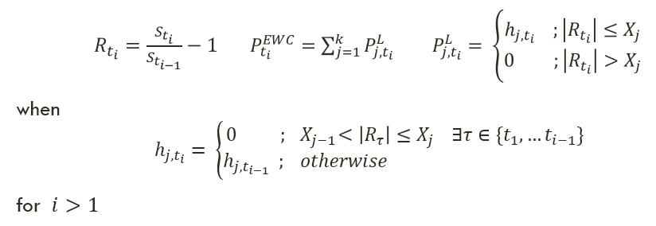
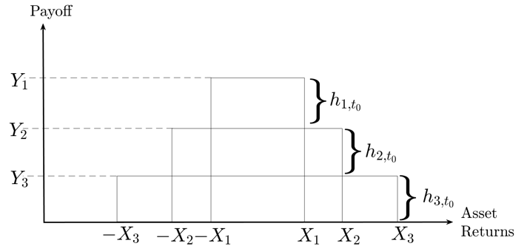
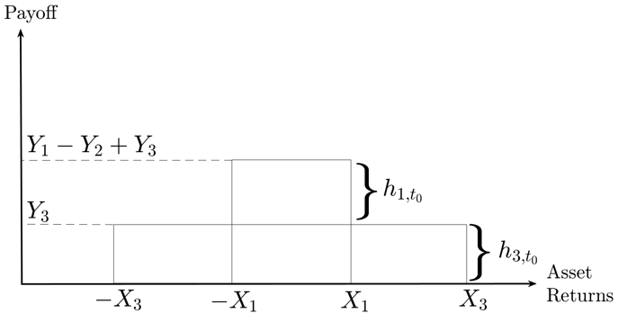


EWC’s Payoff
at $t_{1}$ with $h_{j,t_{0}}=Y_{j}−Y_{j+1}$
at$t_{2}$ when $|R_{t_{1}}|∈(X_{1},X_{2}]$

Slide 7
Motivations for EWC
Volatility Strategy
Discrete → Predictable
Eating → Adaptable

Slide 8
WHY Zero-Centered Layers?
Historical reason
To study growth rate vs volatility
To offset Leverage Effect / Panic Selling

Slide 9
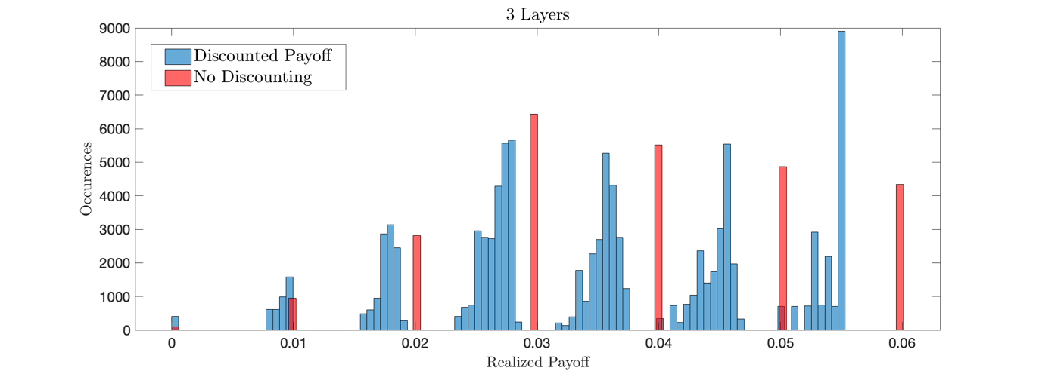
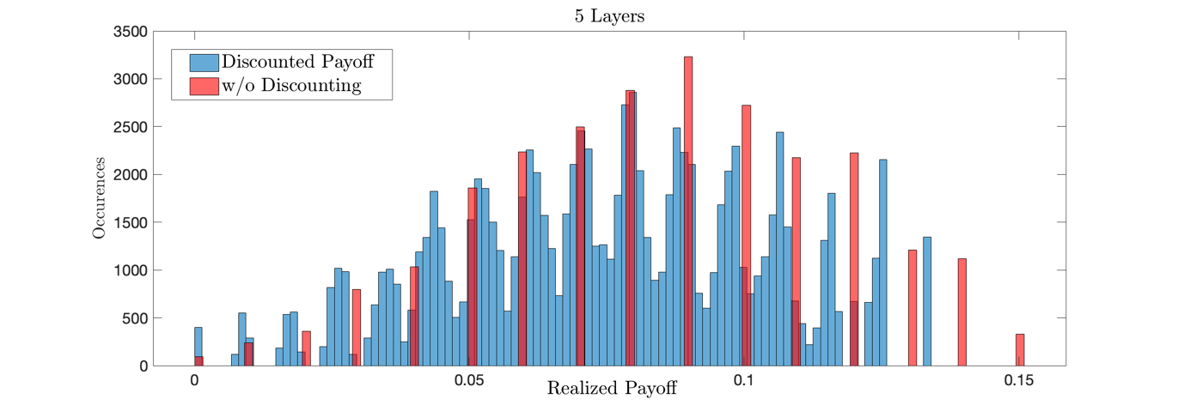
Geometric Brownian Motion (GBM) Payoff
For EWC with few layer → cluster of discounted payoff

Slide 10
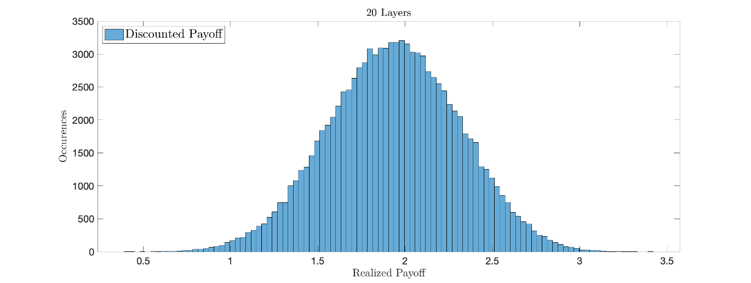
Geometric Brownian Motion (GBM) Payoff
For EWC with large number of layer → Gaussian

Slide 11
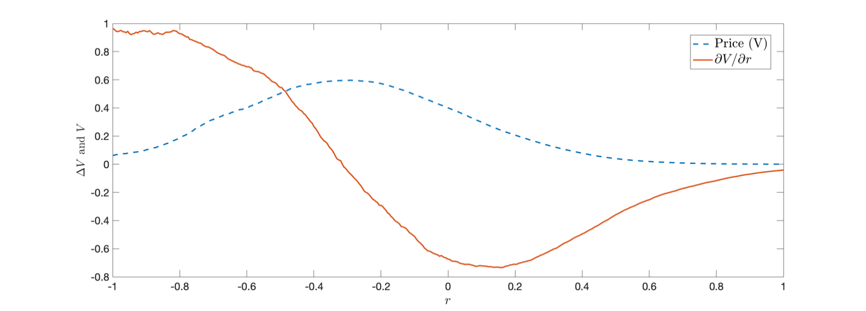
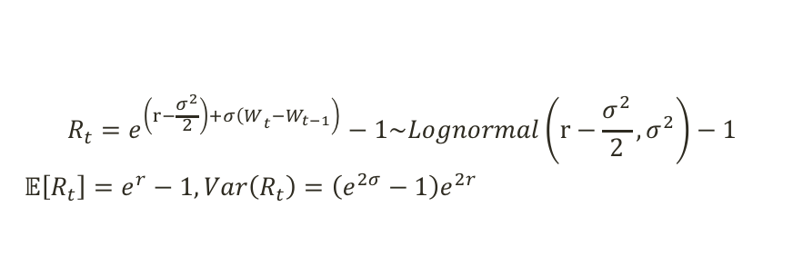
Geometric Brownian Motion (GBM) Delta
$$R_{t}=e^{\left.\left(r−\frac{σ^{2}}{2}\right)+σ{\left(W\right.}_{t}−W_{t−1}\right)}−1\sim Lognormal\left(r−\frac{σ^{2}}{2},σ^{2}\right)−1$$
$𝔼\left[R_{t}\right]=e^{r}−1, Var\left(R_{t}\right)=\left(e^{2σ}−1\right)e^{2r}$

Slide 12
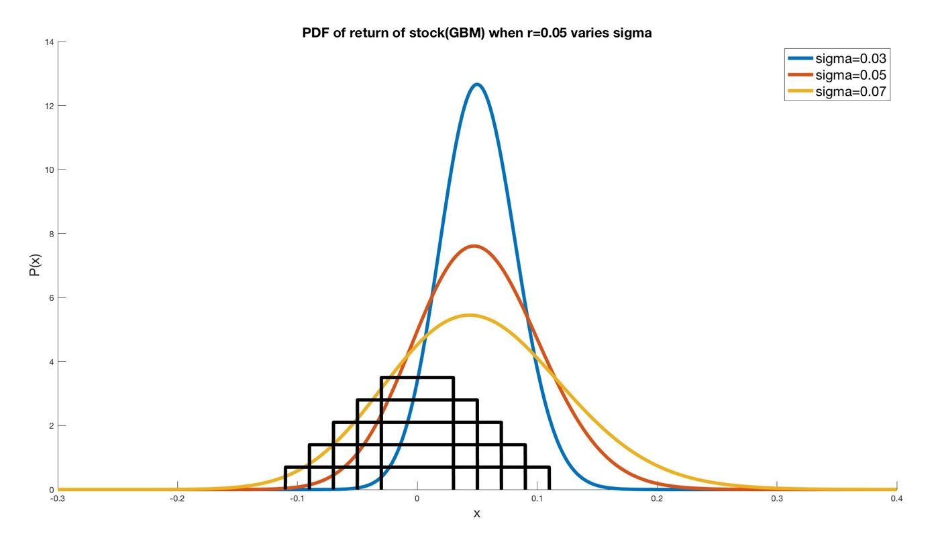
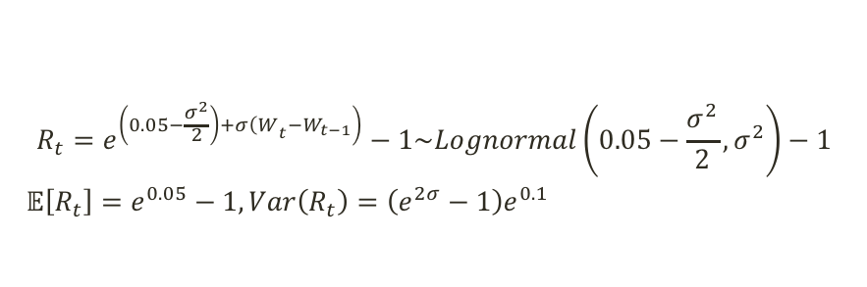

Geometric Brownian Motion (GBM) Vega and Optimal Volatility
$$S_{t_{0}}=100, r=0.05, t_{N}=5$$
$$\left\{X_{j}\right\}=\left\{0.03, 0.05, 0.07, 0.09, 0.11\right\}$$
$$\left\{h_{j,t_{0}}\right\}=\{0.15, 0.13, 0.11, 0.09, 0.07\}$$
$$R_{t}=e^{\left.\left(0.05−\frac{σ^{2}}{2}\right)+σ{\left(W\right.}_{t}−W_{t−1}\right)}−1\sim Lognormal\left(0.05−\frac{σ^{2}}{2},σ^{2}\right)−1$$
$𝔼\left[R_{t}\right]=e^{0.05}−1, Var\left(R_{t}\right)=\left(e^{2σ}−1\right)e^{0.1}$

Slide 13
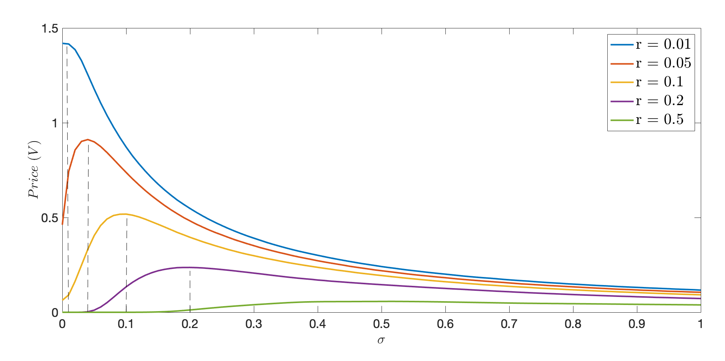
Geometric Brownian Motion (GBM) Vega and Optimal Volatility
$$R_{t}=e^{\left.\left(r−\frac{σ^{2}}{2}\right)+σ{\left(W\right.}_{t}−W_{t−1}\right)}−1\sim Lognormal\left(r−\frac{σ^{2}}{2},σ^{2}\right)−1$$
$𝔼\left[R_{t}\right]=e^{r}−1, Var\left(R_{t}\right)=\left(e^{2σ}−1\right)e^{2r}$

Slide 14
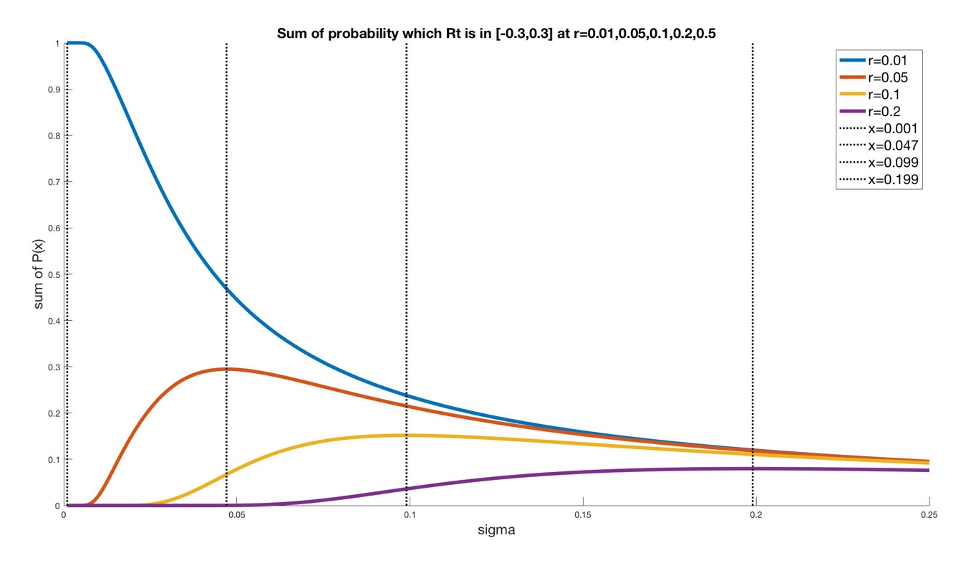
Geometric Brownian Motion (GBM) Vega and Optimal Volatility

Slide 15
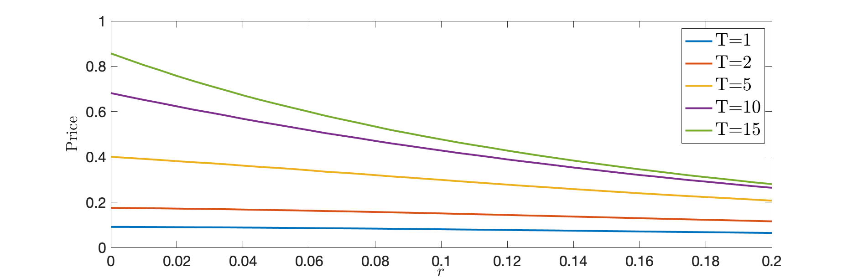
Geometric Brownian Motion (GBM) Duration

Slide 16
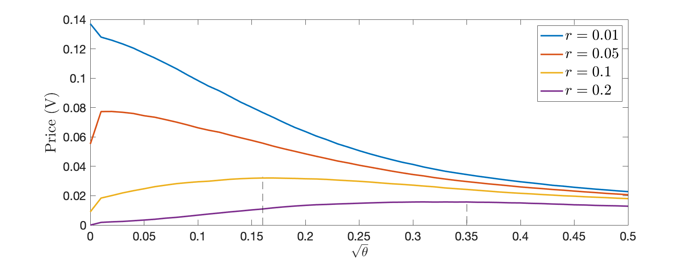
Heston Model Payoff vs theta

Slide 17
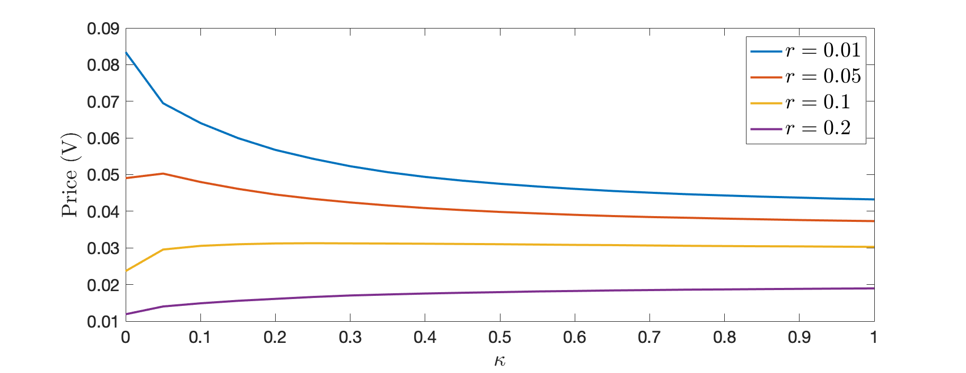
Heston Model Payoff vs Kappa

Slide 18
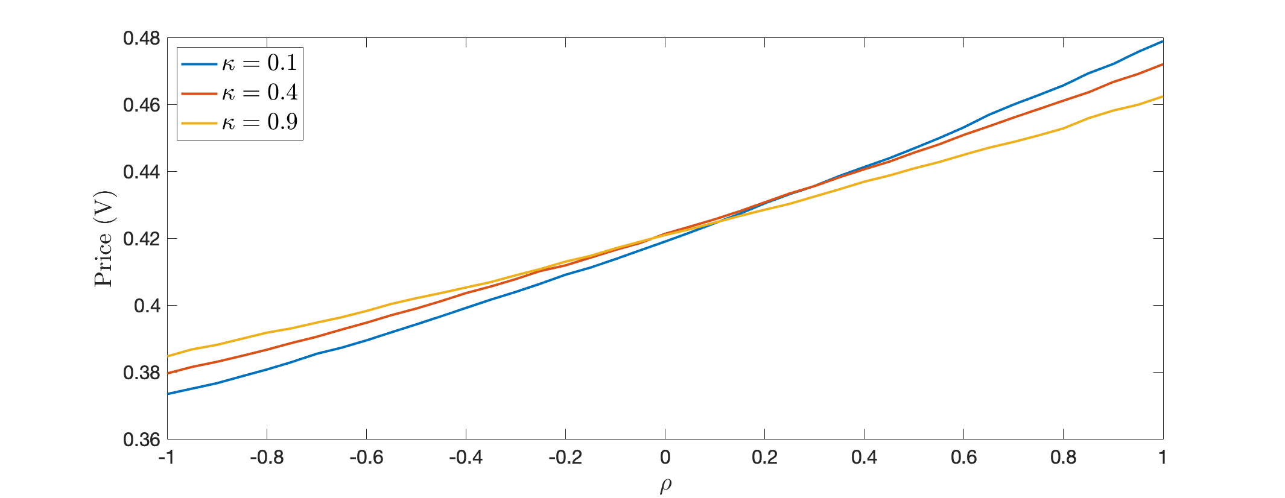
Heston Model Payoff vs Rho

Slide 19
Real-World Implications
Risk-Neutral Measure → Actual Measure
Implied Volatility of stock price

Slide 20
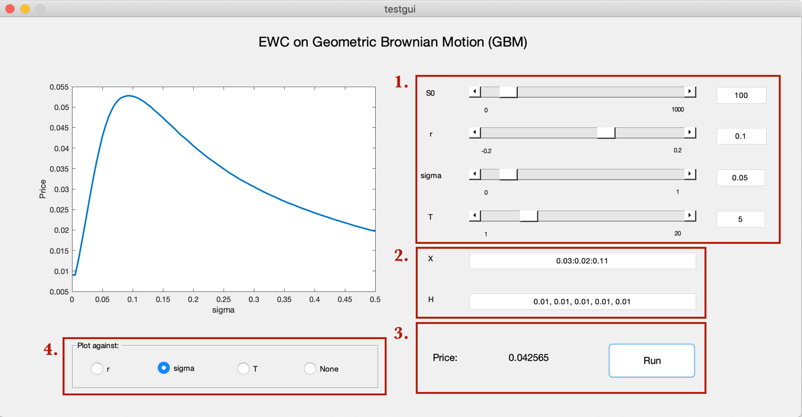
Demo

